Slide 1
Multimedia and Communications II
CS2033a/b
Lecture 11
RSS Feeds
Vivi Tryphonopoulos

Slide 2
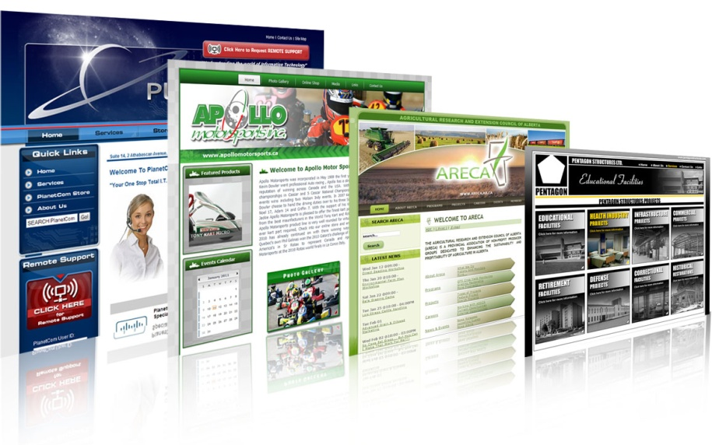

RSS Feeds
A world of:
Blogs
Latest headlines around the world
News breaks as it happens
New company info released etc.
The fact:
Updated info everyday
Do you know when?
How does one handle knowing when there are UPDATES?

Slide 3
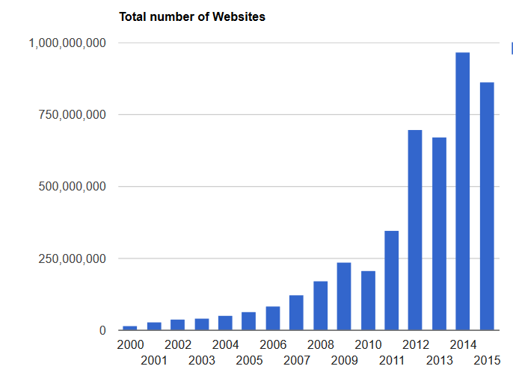
RSS Feeds
Background:
The internet has exploded with the amount of websites and information that it contains.
http://www.internetlivestats.com/total-number-of-websites/

Slide 4
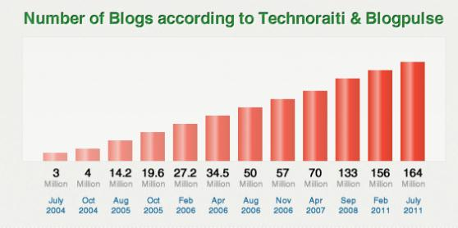
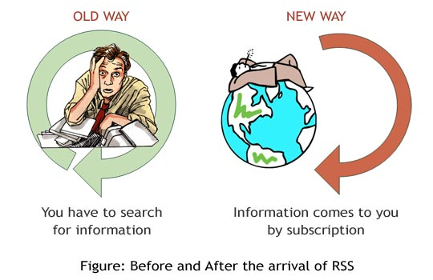
RSS Feeds
Rapid Change:
Information on the internet changes
hard to keep track of it all!
  Constant new stuff!
Information can be anything and everywhere:
blog posts, news stories, articles, etc.
Question:
How do people keep track of these changes?

Slide 5
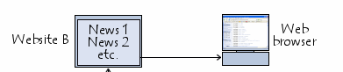
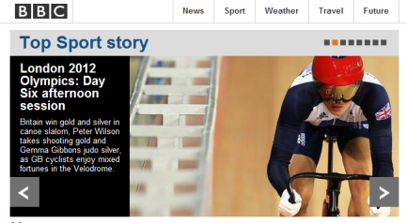
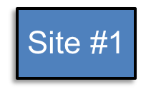

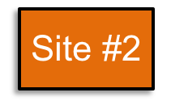
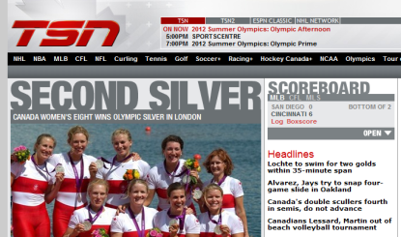
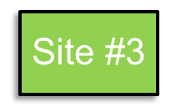
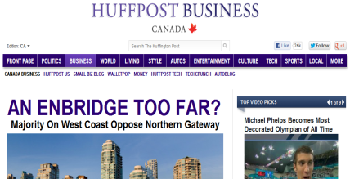
Conventional Method of Accessing Information
RSS Feeds
You visit sites to see what’s new

Slide 6
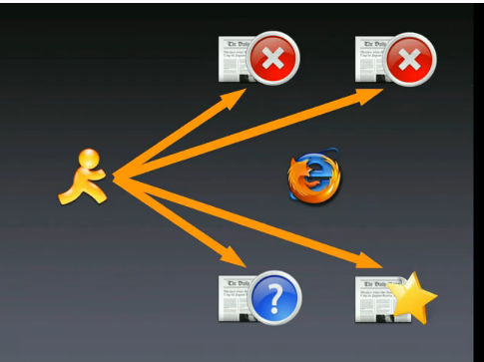
RSS Feeds
Problem with
Conventional Access:
Information that you’re looking for is located across multiple sites
Waste Time - Increasingly time-consuming and cumbersome to access.
Difficult to keep track of where the sites are
When? Don’t know if new information is posted
Solution:
Have information delivered directly to you
You don’t need to access all of your favourite websites individually.

Slide 7
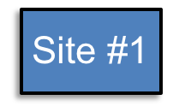
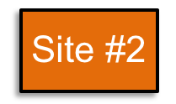
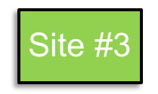
RSS Feeds
Alternative Method
of Accessing Information
Let it come to you!
RSS Technology

Slide 8
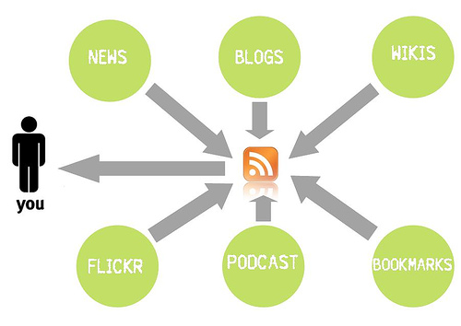
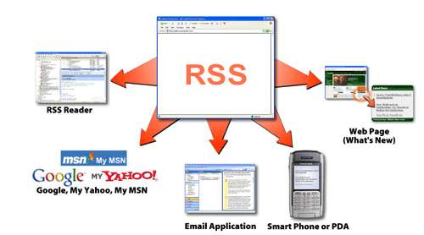
RSS Feeds
Sources to get content from:
What is RSS?
Really Simple Syndication
Syndication means “broadcasting internet content”
  A way of orgs getting “out” up-to-date information
  A way of YOU getting “up-to-date" information without having to visit the site
Most of the biggest names on the web offer content feeds including
CBC.ca
USATODAY.com
How is Internet Syndication
achieved using RSS?

Slide 9
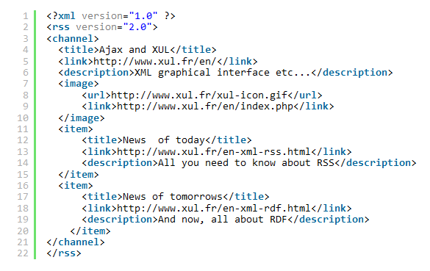
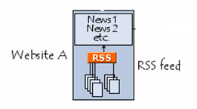
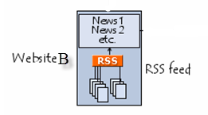
RSS file = also called
RSS feed or RSS channel
contains information to be distributed
is kept up-to-date so that it always contains the latest published information.
RSS Feeds
How is Internet Syndication
achieved using RSS?
Many news-related sites, weblogs and other online publishers syndicate their content as an
RSS Feed to whoever wants it.
Webmasters create an RSS file containing headlines and descriptions of specific information.
RSS is a standardized file format written in XML (eXtensible Markup Language)
XML is a language used to feed out Internet published information that frequently changes
CNN
Developers can embed RSS feeds in their iPhone apps, Android apps ans mobile Web apps.
CBC

Slide 10
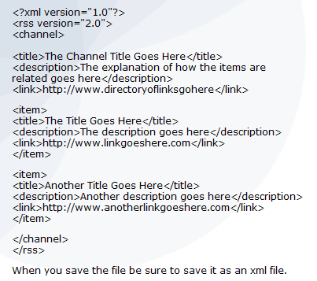
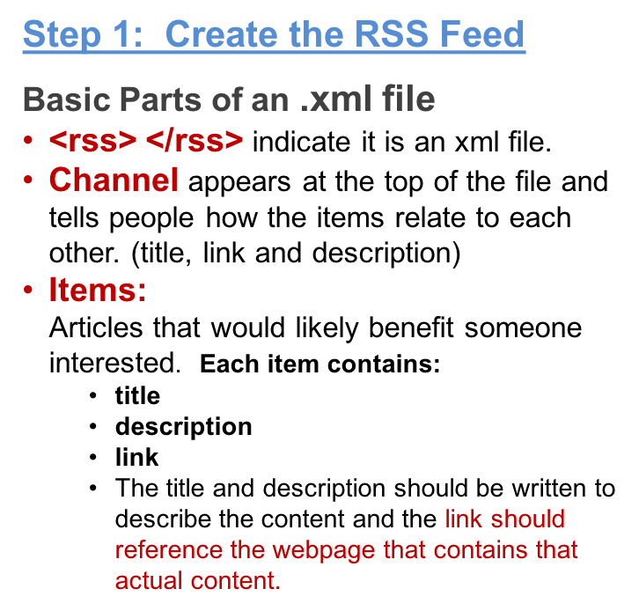
RSS Feeds
How to create an RSS Feed (.xml file)
Create the RSS feed(.xml)
Validate the RSS feed (for errors)
Syndicate/Submit it

Slide 11
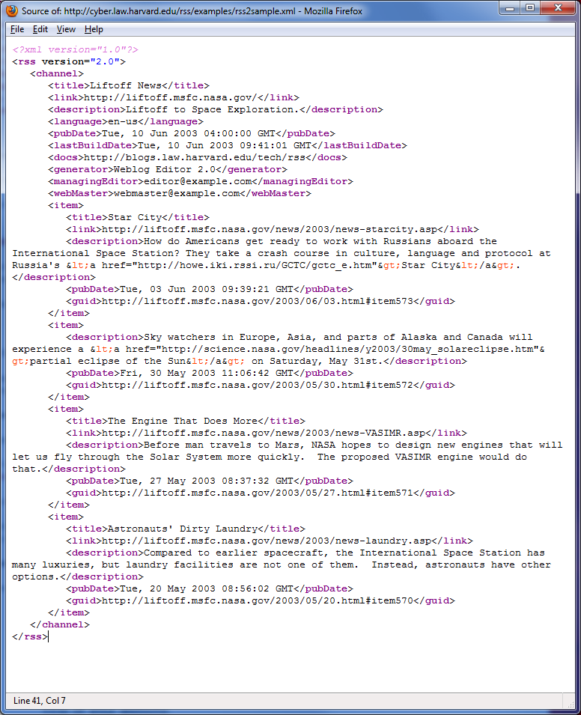
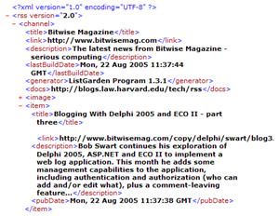
RSS Feeds
More XML Examples

Slide 12
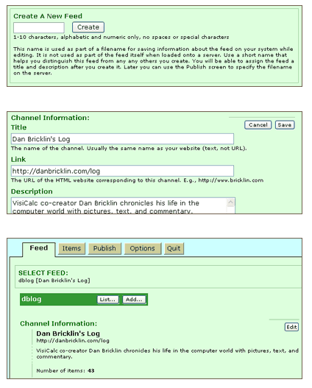
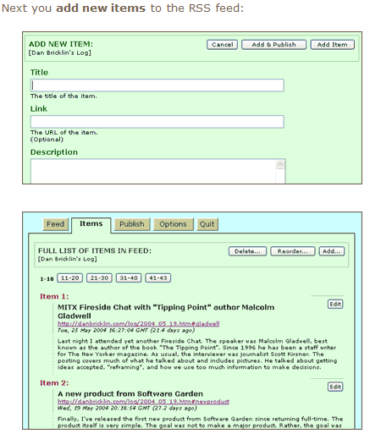
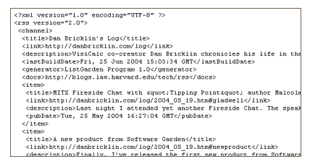
RSS Feeds
RSS Feeders: (RSS Generators)
A program to allows users to easily create XML, edit and publish RSS feeds.
Some can even create podcasts (including iTunes compatible podcasts).
Popular Feeders:
Feedforall ($39)
Listgarden (free –nosupport)
http://www.rssgenerator.net/ (free)
A list of free ones:
http://www.feed-readers.com/free-rss-readers.htm
Generates .xml

Slide 13
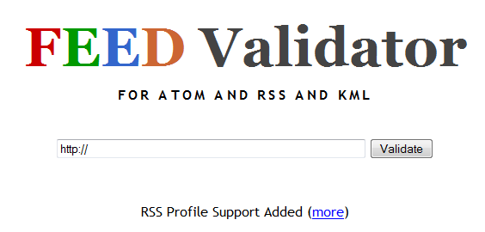
Popular RSS Feed Validators
http://www.weblogs.com/feedvalidator.html
http://feedvalidator.org/
http://feedvalidator.org/testcases/
RSS Feeds
How to create an RSS Feed (.xml file)
Create the RSS feed(.xml)
Validate the RSS feed (for errors)
Syndicate/Submit it
Step 2: Validate the RSS Feed
(locally on system or do Step 3 and then validate. (rss feed validators want it online)
Many feed readers will not accept invalid blog/site feeds.
So it is better to validate your site’s feeds first.
Validators help you to codify the specification (literally, to translate it into code) to make it easier to know when you’re producing RSS correctly, and to help you fix it when you’re not.
It works with RSS 0.90, 0.91, 0.92, 0.93, 0.94, 1.0, 1.1, and 2.0.
Try it with:
http://feedvalidator.org/testcases/rss20/element-channel/missing_channel_description.xml
Enter the address of your feed and click Validate.
http://www.yoursite.com/yourfeed.xml
If find errors:
Provides messages for each type of problem and highlights where the problem first occurs in your feed.

Slide 14

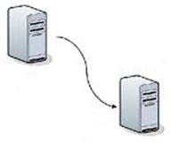
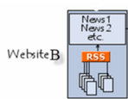
RSS Feeds
How to create an RSS Feed (.xml file)
Create the RSS feed(.xml)
Validate the RSS feed (for errors)
Syndicate/Submit it
Step 3: Syndicate/Submit it
Upload the XML file to your web server.
The URL will be something like :
http://www.yoursite.com/yourfeed.xml.
This is the link to your RSS/XML feed, and the one you'll be advertising so people can subscribe.
So any time you add a new article to your feed, you must upload the XML which shows the latest updates.
Some RSS Generators:
Have a built-in upload feature so you can upload the XML file right to your web server assuming your web host has FTP access.

Slide 15
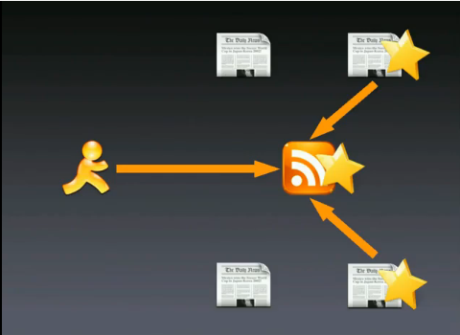
RSS Feeds
Subscriber: How to Get Started
Find the sites you are interested in.
(Not everybody offers RSS feeds)
Subscribe to a website’s feed and have that content show up in your own personal feed
  Subscribe to multiple websites’ RSS feeds, and access all of that information in one central feed location (using a reader)
  New content from subscribed websites automatically show up in your feed.
You Need to get a:
Subscription to an RSS feed
Read your feeds
(to view the feeds)

Slide 16
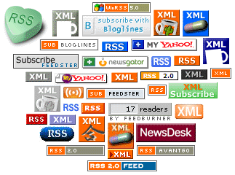


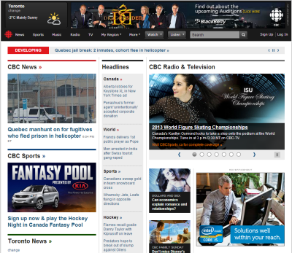
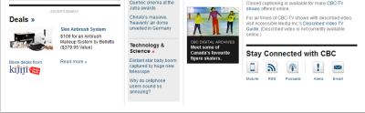
RSS Feeds
How to Get Started:
Subscriber
Find the sites you are interested in.
Look for any indication for the RSS button
Click on it
In Firefox:
You can check by bookmarking and it will allow you to subscribe if there is a Feed
Most of the biggest names on the web offer content feeds including
CBC.ca
USATODAY.com
BBC News Headlines
ABCNews
CNET
Yahoo!
Amazon.com
(including a podcast!), and many more.
Notes:
NOT ON EXAM

Slide 17
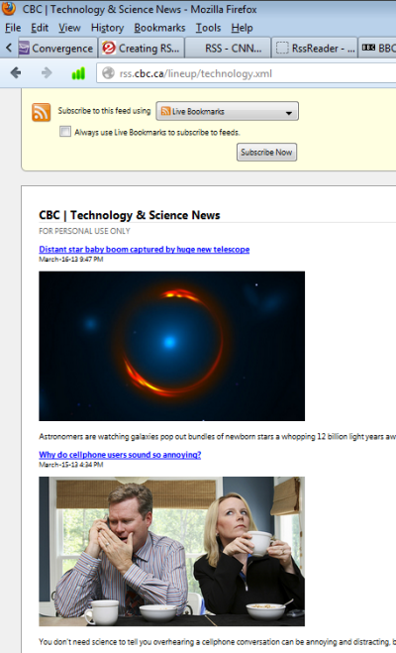
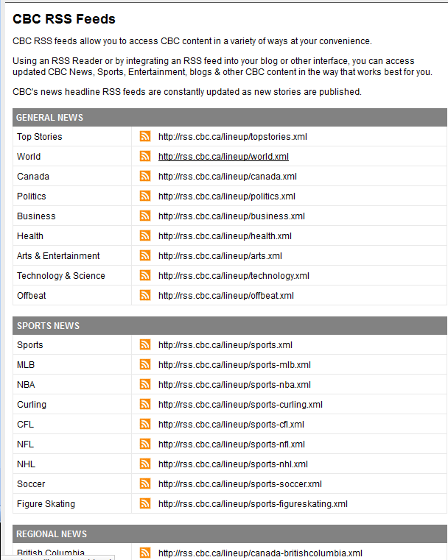
http://www.bbc.co.uk/news/entertainment-arts-21821319
RSS Feeds
Presents you with all the RSS feeds that this site offers:
Copy the link (.xml) and paste into Reader because browsers such a Chrome can’t read the .xml file
In Firefox
Built-in RSS Feeder
Clicked on .xml button and open up the feed. Most browsers don’t have
Notes:
Not HTML, it’s xml

Slide 18
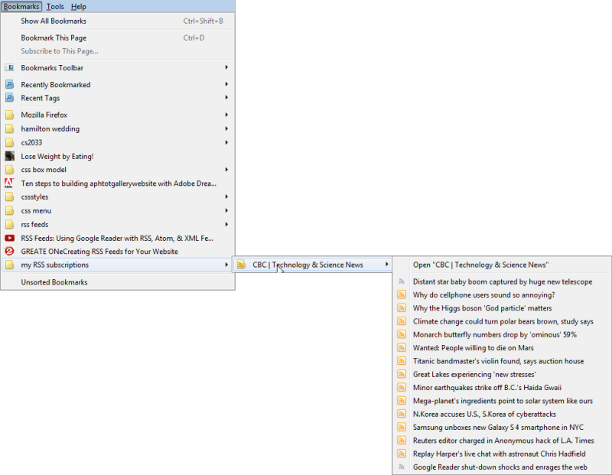
RSS Feeds
When you saved it as a Live Bookmark in Firefox.. To read go to your bookmark and view the articles
Go directly to the feed or go to the topic with all the feeds
Really annoying because it opens up same window/tab and can’t bet back to it.. Unless you start from browser Bookmarks again…
So get a RSS Reader
Notes:
Viewing Your Feed in Firefox

Slide 19
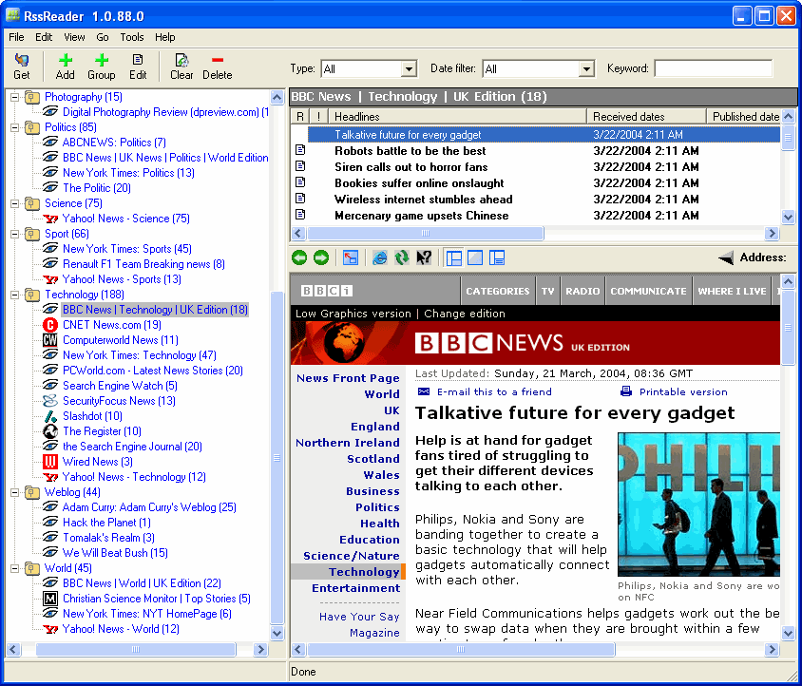
RSS Feeds
Get RSS Reader
(aka aggregator, feed reader)
To read your RSS feeds, you need an RSS reader
Aggregates (forms into one) syndicated web content such as news headlines, blogs, podcasts, and video blogs (vlogs) in one location for easy viewing.
There are many readers available, with a wide variety of approaches and features.
    web-based vs stand-alone programs
    operating systems specificity
    some are free vs. to pay for them
    Just search “RSS reader” and find what works best for you.

Slide 20
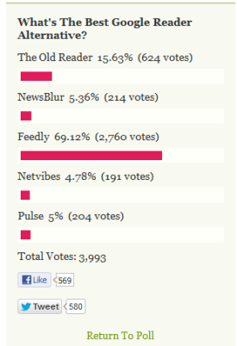
http://lifehacker.com/5990881/five-best-google-reader-alternatives
Google Reader
Stopping service July 1, 2013
The Old Reader
NewsBlur
Feedly
NetVibes
Pulse
Find the RSS feed that you would like to subscribe to
Copy and paste the link into your RSS reader… that’s it!
Any updates will be displayed next time you access your reader.
Online (web based)
Bloglines
Feedshow
Google Reader
My Yahoo
Newsgator Online
Netvibes
Microsoft
Awasu
Blog Navigator
FeedDemon
NewzCrawler
Omea Reader
RSS Reader
Sharp Reader
Thunderbird
Apple
Cyndicate
NetNewsWire
NewsFire
PixelNews
Shrook
Thunderbird
Vienna
Linux
Akregator
BlogBridge
Bottom Feeder
Eclipse RSS Reader
Liferea
RSS Owl
SnowNews
Straw
Thunderbird rdz
Notes:
NOT ON EXAM

Slide 21
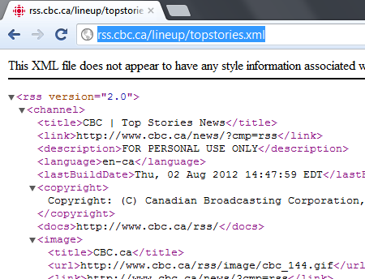
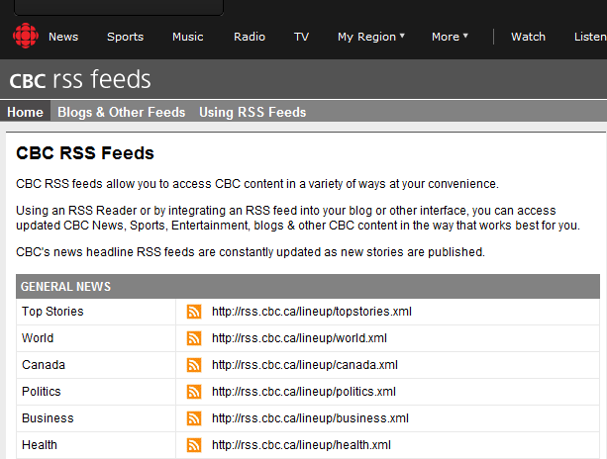
Get the RSS Feed that you want
Click on the RSS button
It will open in browser the .xml file
Copy the url address into the rss reader of your choice

Slide 22
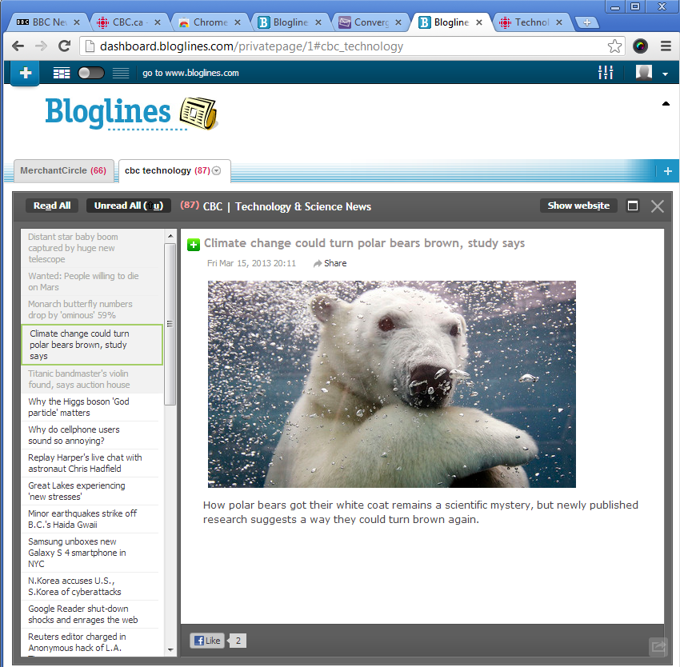
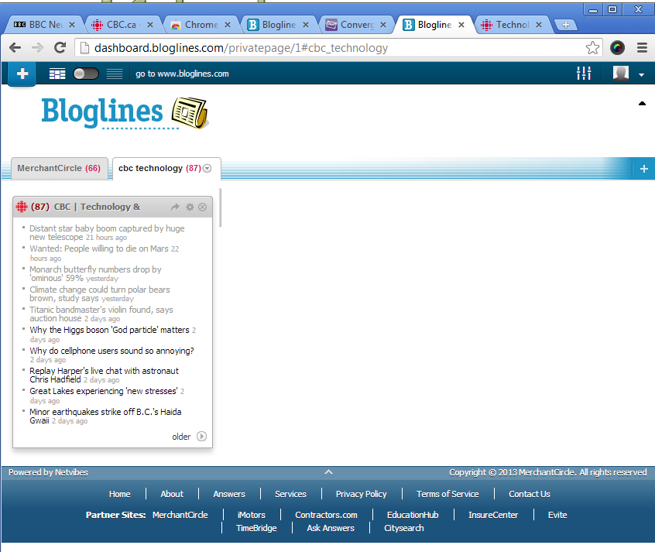
Bloglines.com

Slide 23
RSS Feeds

Slide 24
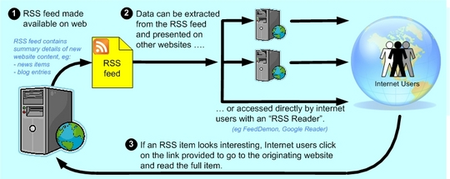
RSS Feeds
How does RSS Feed Work?
The Publisher:
Wants to broadcast the content
The Subscriber
Wants to read updated info
Identifies the web pages that will be displayed by other websites
This set of pages is the RDD feed.
A webmaster of this site defines this RSS feed using an XML file which holds: URL, title and summary
Consumers use RSS readers and news aggregators to collect and monitor their favorite feeds in one centralized program or location.
http://share.ez.no/learn/ez-publish/how-to-import-and-export-rss-feeds
Notes:
Chart not on exam

Slide 25
RSS Feeds
Benefits of RSS:
For The Publisher:
Wants to broadcast the content
For The Subscriber
Wants to read updated info
Increase traffic to their site!
→ it’s all about Syndication
Allows you to reach a much larger audience.
Establish a direct connection between you and your subscribers
“RSS readers are loyal readers”
Improves your search engine ranking
Monitor their favorite feeds in one centralized program or location.
Benefit from automatic updates from your subscribed feeds.
If RSS feed embedded into your website:
Keep bringing people back to your site if you have RSS feed on your website
Then your site enjoys better search engine rankings as search engine spiders always love fresh content.
RSS comes in handy for websites that are updated frequently
  Rapidly changing content
  News sites, blogs, podcasts etc.

Slide 26
This Week
Try RSS Feed Examples yourself..
The only way to learn!
LABS:
This Week: E-commerce and creating a storefront
Worth 2%

